Slide 1

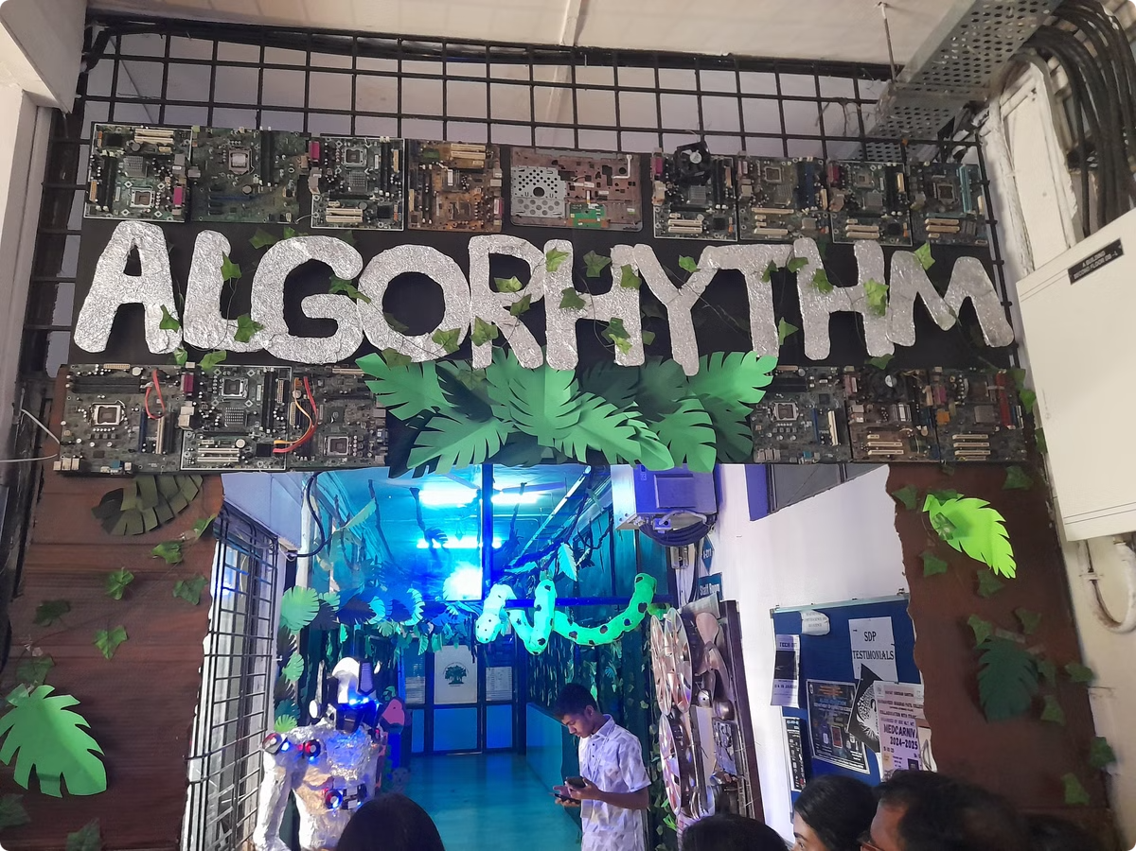
Algorhythm Tech-Fest Dashboard
This presentation summarizes the Algorhythm Tech-Fest Dashboard project, developed to provide insightful analysis of sponsorships, expenses, and participation trends. The dashboard aims to modernize event management by offering automated, real-time insights that enhance the sustainability and scalability of Algorhythm.
By leveraging interactive visualizations and business intelligence techniques, the dashboard helps organizers identify trends, optimize budget allocations, and enhance strategic planning for future editions of the fest. It ensures transparency in financial transactions and effective resource allocation.
By Atharva Shelar

Slide 2

Objectives and Purpose
1
Financial Analysis
2
Performance Evaluation
3
Trend Visualization
Analyze sponsorships and expenses over different years to identify trends and ensure financial health.
Assess the performance of various sub-events based on revenue and participation data.
Provide clear and interactive visual representations of key event metrics.
The dashboard offers a centralized platform to visualize and analyze financial and event-related data efficiently. It consolidates historical and real-time data, providing meaningful insights that support strategic planning and operational improvements for the Algorhythm fest.

Slide 3

Challenges with Existing Systems
Lack of Real-Time Insights
Static Reports
Limited Customization
Traditional spreadsheets provide static reports that require manual filtering and sorting to extract insights.
Existing systems do not offer real-time data updates, leading to manual entry and delayed access to updated financial reports.
Existing tools do not provide customized KPIs based on event-specific metrics, hindering tailored analysis.
Traditional spreadsheet-based solutions and manual bookkeeping methods have significant limitations, especially when dealing with large-scale events like Algorhythm. These methods lack real-time insights, offer static reports, and struggle with large datasets.

Slide 4




Technology Used
Power BI
DAX
Python
Used for creating interactive dashboards and reports, integrating with Excel and other data sources.
Formula language used for creating calculated columns, measures, and custom aggregations.
Used for data preprocessing, transformations, and automation, enhancing data cleaning and statistical analysis.
The Algorhythm Power BI dashboard utilizes a combination of business intelligence tools, data analytics techniques, and scripting languages to ensure a smooth, efficient, and insightful user experience.

Slide 5
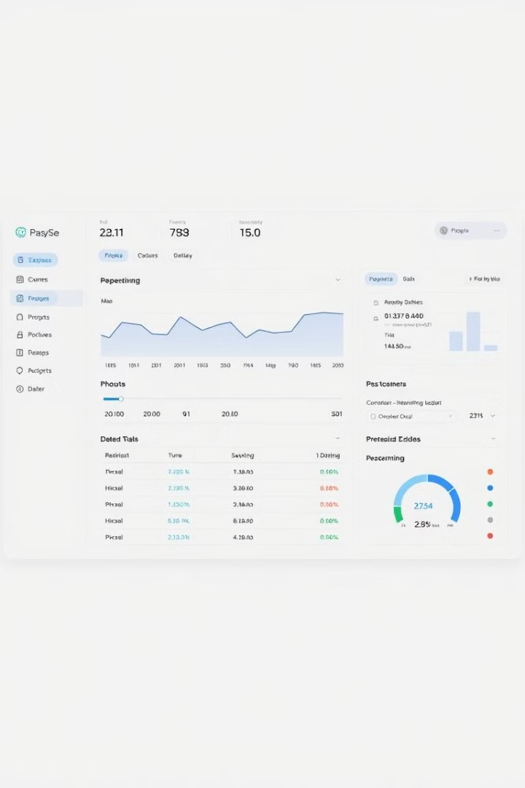
Functional Requirements
Display Data
Interactive Insights
Visually represent sponsorship revenue and expenses for different years, categorized by sponsorship tiers and expense types.
Enable users to filter and analyze data using slicers for year, sponsorship type, expense category, and sub-event name.
Cumulative Metrics
Display cumulative revenue and expense growth over time, with year-over-year comparisons and trend lines.
Functional requirements define the core features and capabilities of the Power BI dashboard, ensuring that the system effectively meets the expectations of event organizers and stakeholders.

Slide 6
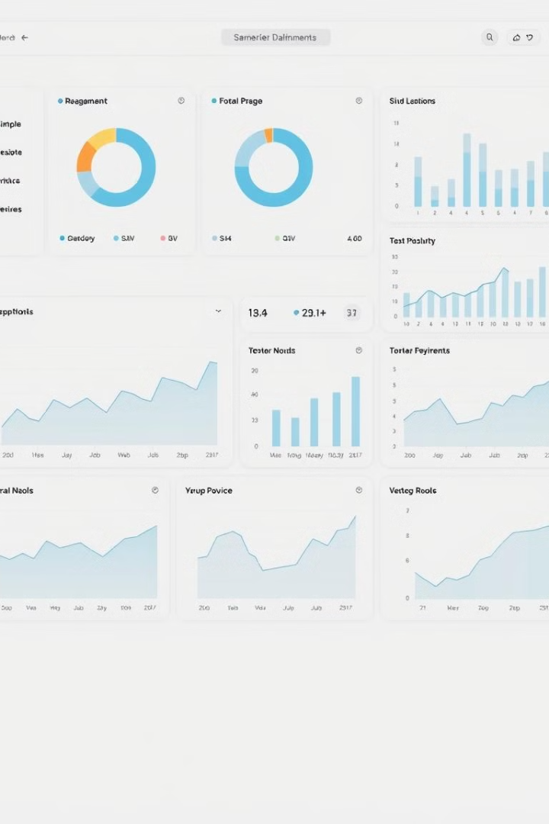



Dashboard Components
Home Page
Provides a summary of key financial metrics, including total sponsorship, total expenses, and revenue growth trends.
Tech Fest Insights
Presents an overview of sponsorship trends, expenses, and participation, using interactive slicers to filter data.
Sub-Event Breakdown
Analyzes individual sub-events, displaying event-wise sponsorship distribution and participation trends.
The Power BI dashboard consists of multiple components that work together to create an intuitive and user-friendly interface. Each component serves a specific purpose in presenting data insights in a structured and meaningful way.

Slide 7

DAX Queries Used
1
Cumulative Revenue
Calculates the running total of revenue over time, tracking accumulated sponsorship revenue at any given point.
2
Ranked Sub-Events
Assigns rankings to sub-events based on the number of participants, highlighting the most popular sub-events.
3
Total Revenue
Directly sums up the total revenue from sponsorships and participation fees, providing a key performance indicator.
DAX (Data Analysis Expressions) is a powerful formula language used in Power BI for creating calculated columns, measures, and custom aggregations. These queries compute financial metrics and rankings.

Slide 8
Testing Strategy
Unit Testing
Integration Testing
User Testing
Validate individual DAX calculations to ensure correctness, applying different filters and cross-verifying against raw data.
Verify that all visual components interact correctly with data sources, ensuring seamless user experience.
Gather feedback from event organizers and sponsors on usability, improving the user interface and interaction.
To ensure the reliability and accuracy of the Power BI dashboard, a comprehensive testing strategy was applied, including unit testing, integration testing, and user testing.

Slide 9




Conclusion and Further Work
Real-Time Data
1
AI Predictions
2
4
Mobile Access
3
Automated Reports
The Power BI dashboard has successfully provided a comprehensive data visualization platform for the Algorhythm Tech Fest. Future enhancements include real-time data integration, AI-based predictions, automated report generation, and mobile compatibility to provide even deeper insights and convenience.

Slide 10
Thank You

